Slide 1
How does fish manage gas change in swim bladder
2111524 刘浩楠

Slide 2
The brief introduction of swim bladder
01
The gas change of physostomous fishes
目 录
02
The gas change of physoclistous fishes
03

Slide 3
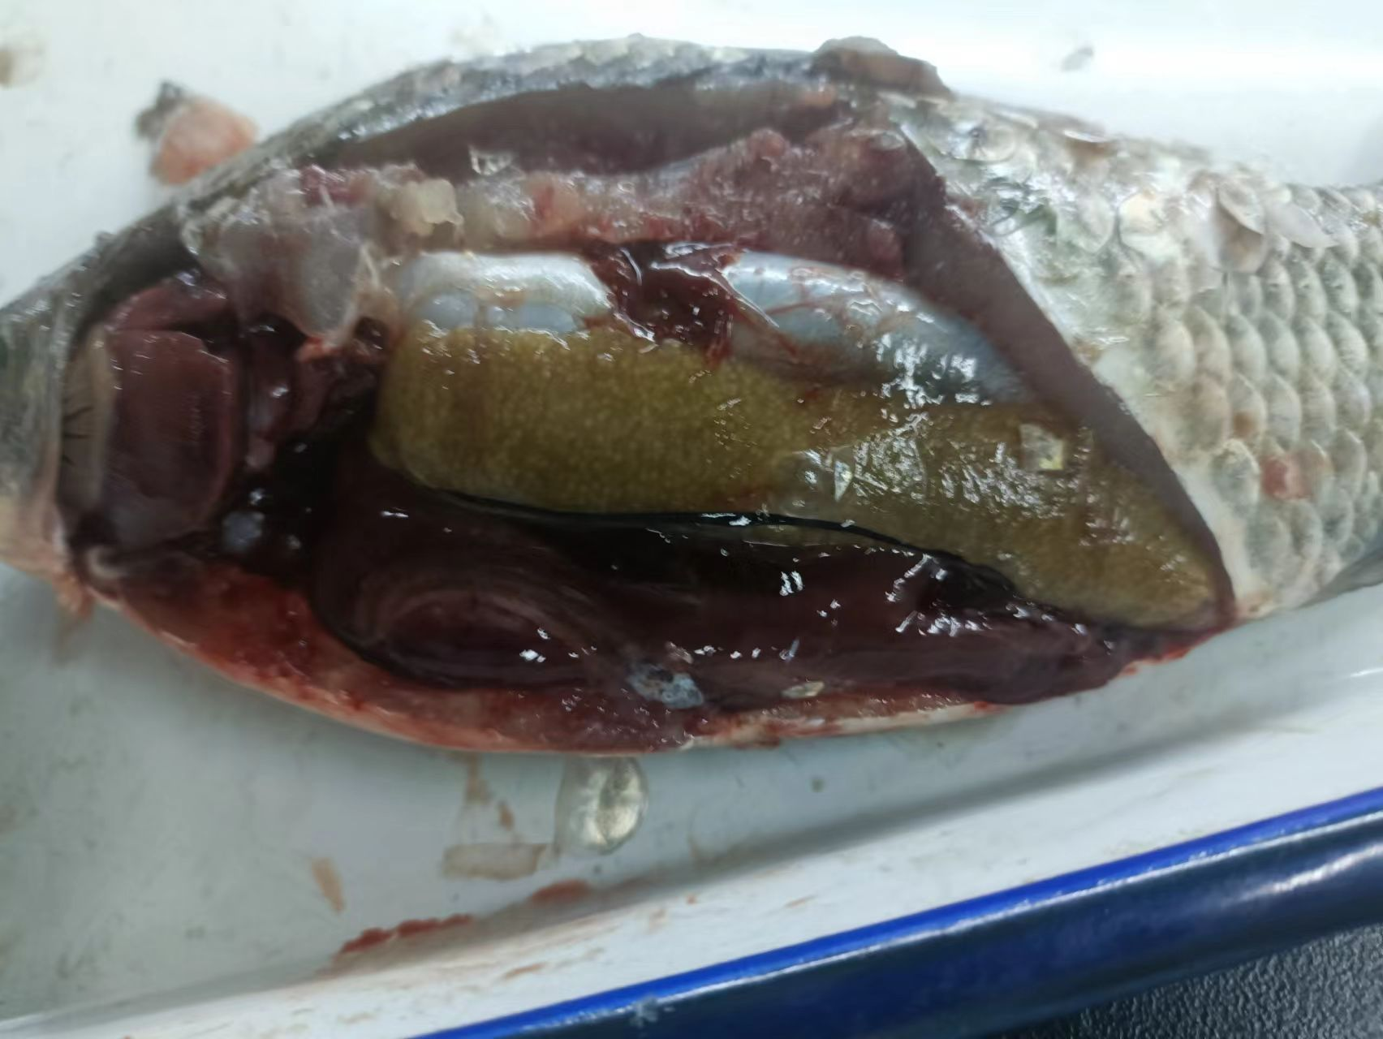
The brief introduction of swim bladder
The swim bladder is an internal gas-filled organ that contributes to the ability of many bony fish (but not cartilaginous fish) to control their buoyancy, and thus to stay at their current water depth without having to expend energy in swimming.
the swim bladder of crucian

Slide 4
The brief introduction of swim bladder
It is filled with carbon dioxide, oxygen, and nitrogen in different proportions than occur in air.
The gas bladder is a two-layered (tunica externa and tunica interna), specialized outgrowth of the roof of the foregut and possesses tissues similar to those of the foregut.The walls of the gas bladder are lined with a layer of cells containing crystals of guanine 3 µm thick, which decreases permeability by 40 times over an unlined membrane and thus limits gas escape except at the oval, when it is open.
Physostomous fishes retain the connection in adults, whereas physoclistous fishes lose the connection in adults, if it is present at all during development.

Slide 5
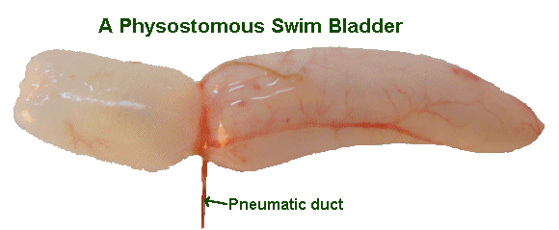
The gas change of physostomous fishes
In physostomous fishes swim bladders, a connection is retained between the swim bladder and the gut, the pneumatic duct, allowing the fish to fill up the swim bladder by "gulping" air. Excess gas can be removed in a similar manner.

Slide 6
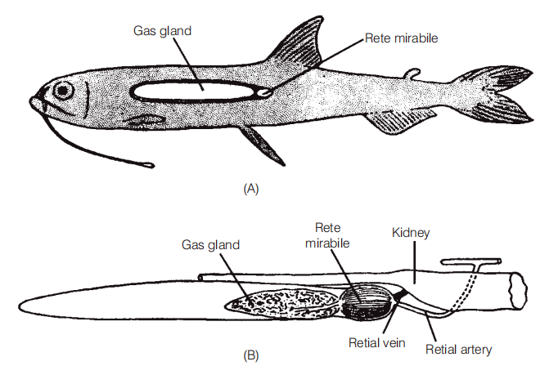
The gas change of physoclistous fishes
The anteroventral secretory region contains the gas gland and the rete mirabile.
The gas gland secretes lactic acid into the beginning of the capillary loop. This acidifies and reduces the solubility of all dissolved gases. A change of 1 pH unit releases 50% of the oxygen bound to hemoglobin. This raises the partial pressure of blood oxygen by the Root and Bohr effects

Slide 7
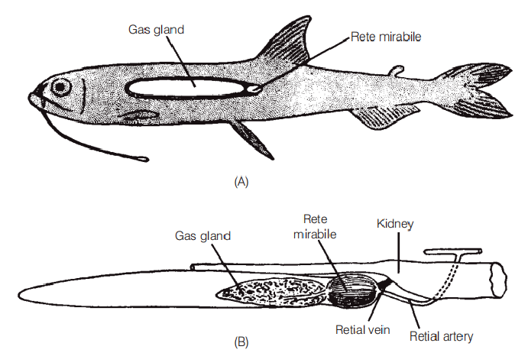
The gas change of physoclistous fishes
The rete mirabile, is a looping bundle of arterial and venous capillaries associated with the gas gland that functions as a counter-current multiplier.
The rete mirabile is better developed in deep dwelling fishes that have longer retial capillaries, thus providing more surface area and allowing a greater multiplying factor.

Slide 8
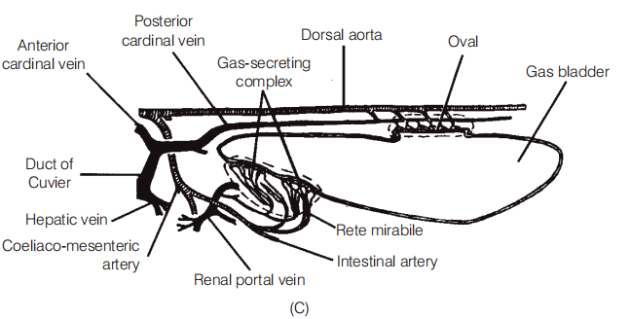
The gas change of physoclistous fishes
The posterodorsal resorptive region of the gas bladder is called the oval. It develops from the distal end of the degenerating pneumatic duct and consists of a thin, highly vascularized area.
Circular muscles contract and close off the oval, preventing outflow of gases.Longitudinal muscles contract and expose the oval, permitting gas escape.

Slide 9
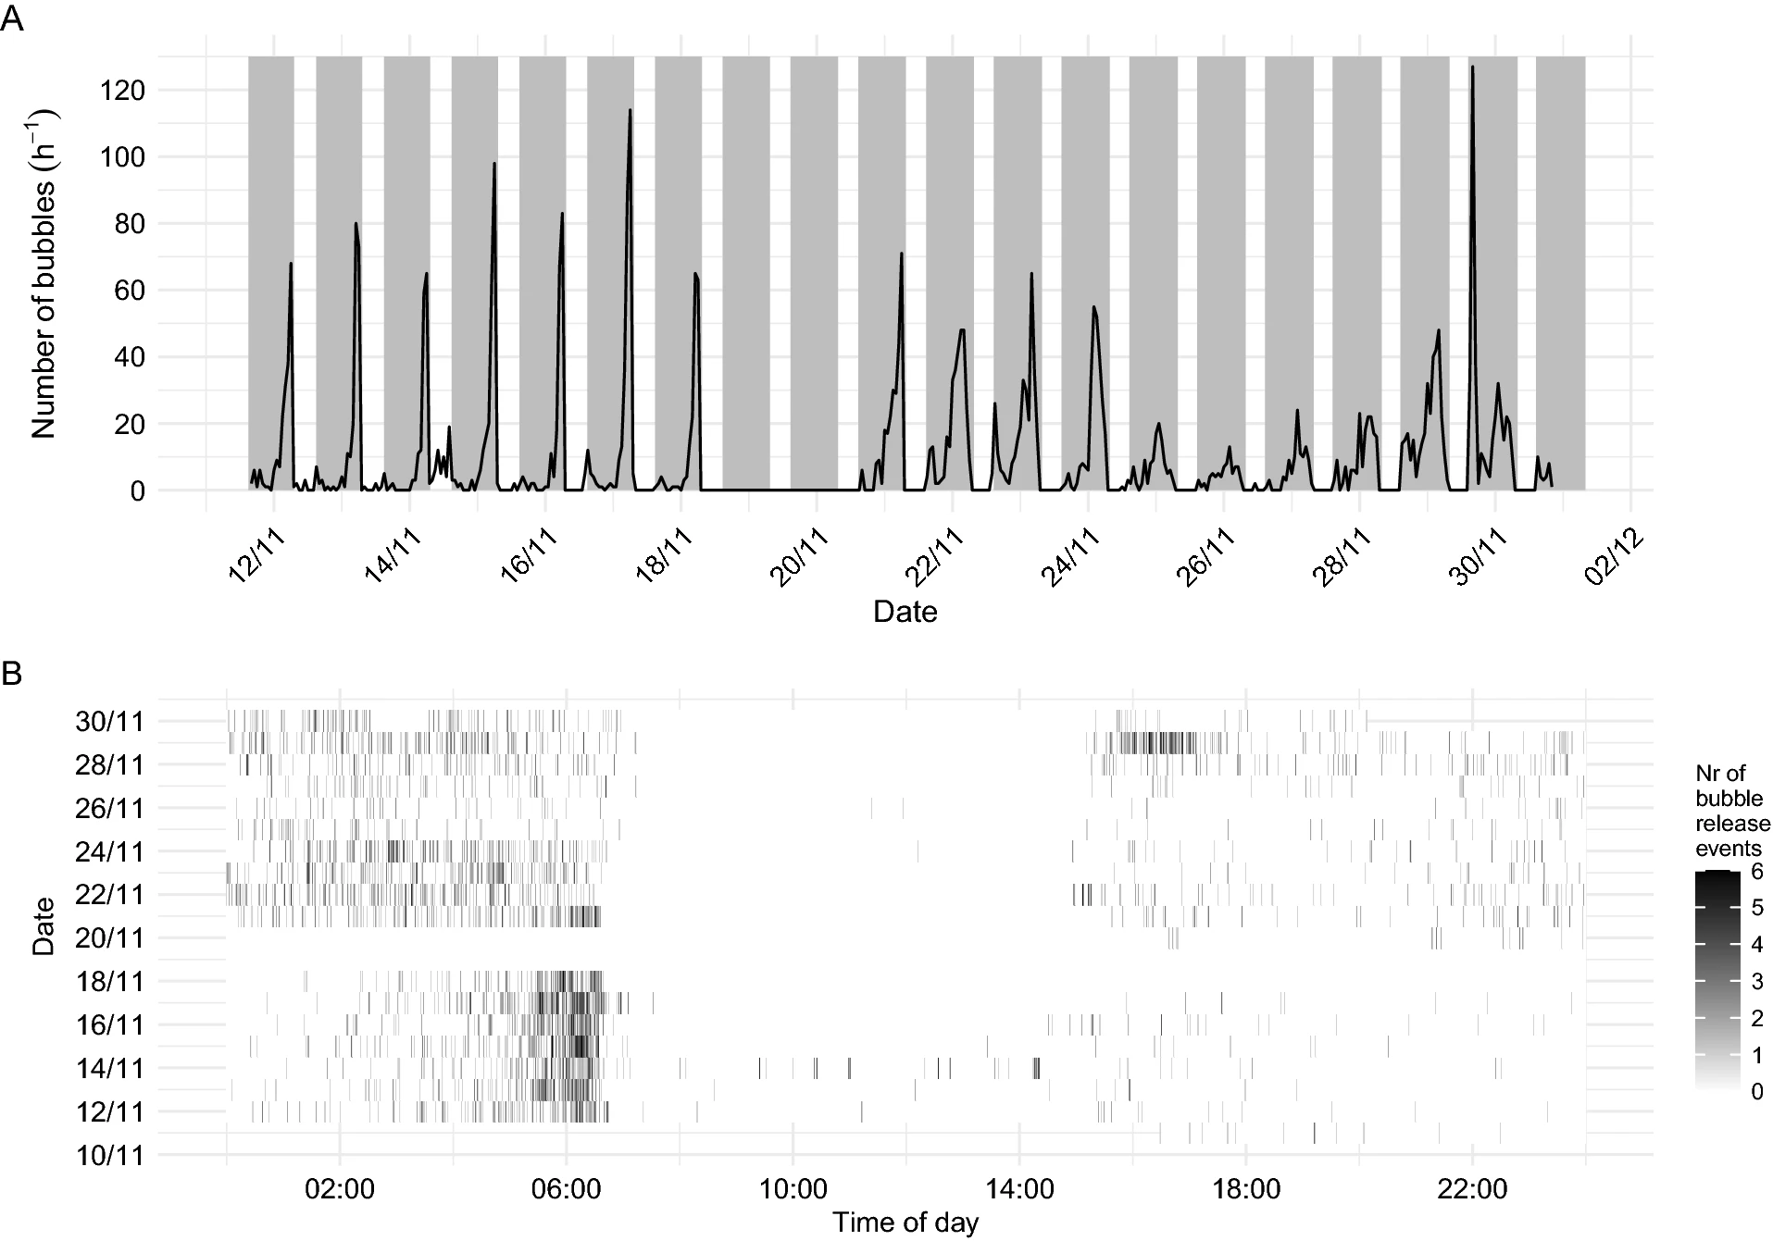
Researcheres investigate the sprat in Bunnefjorden, Norway.The gas release primarily occurred at night, partly following recurrent temporal patterns.They think the non-random gas release may associate with the sophisticated behavioral modes, such as communication and active modes of predator escape and avoidance.

Slide 10
Question
The research was carried out at Norway where the sea water would be frozen,but the sprat can also absorb and release the gas,how can they do that?

Slide 11
Thanks for your listening

